Slide 1
GATTING STARTES WITH
MS EXCEL

Slide 2
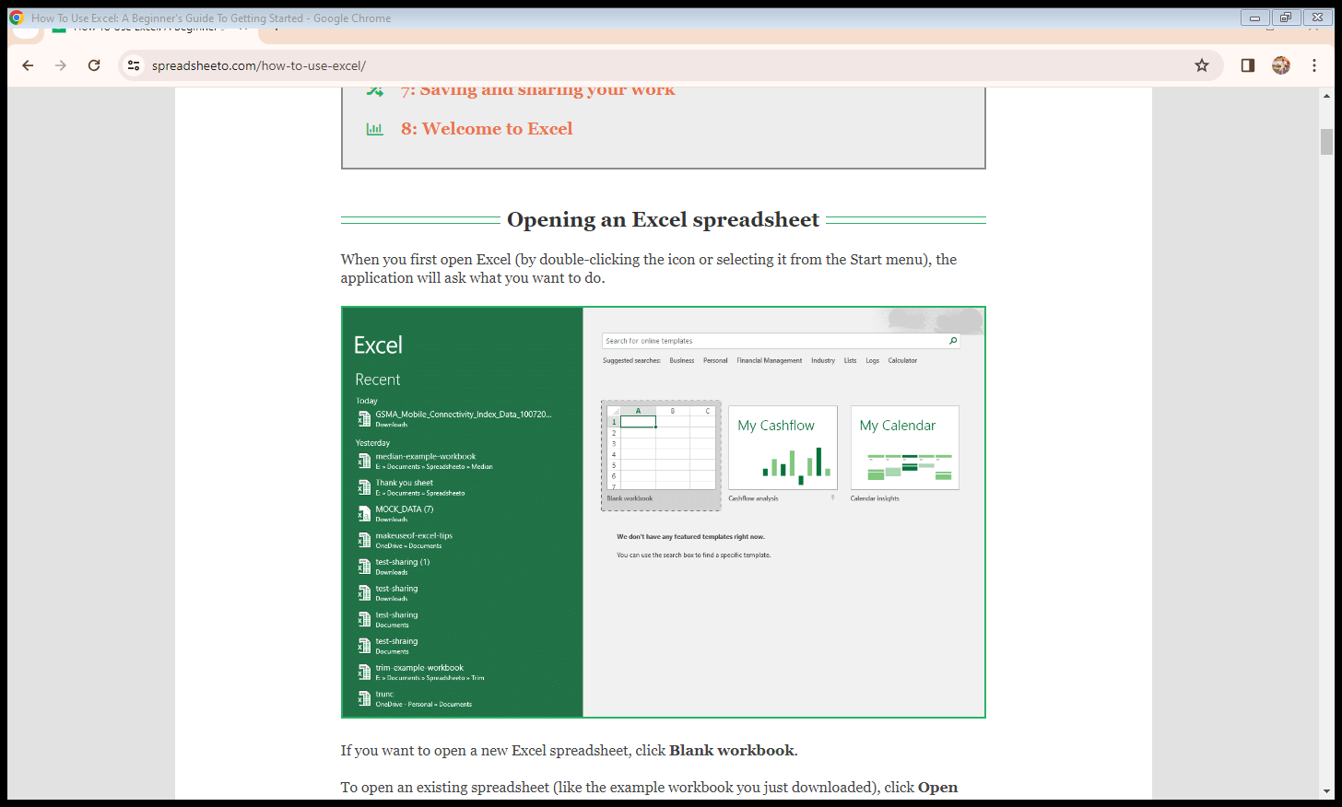
Opening an Excel spreadsheet

Slide 3

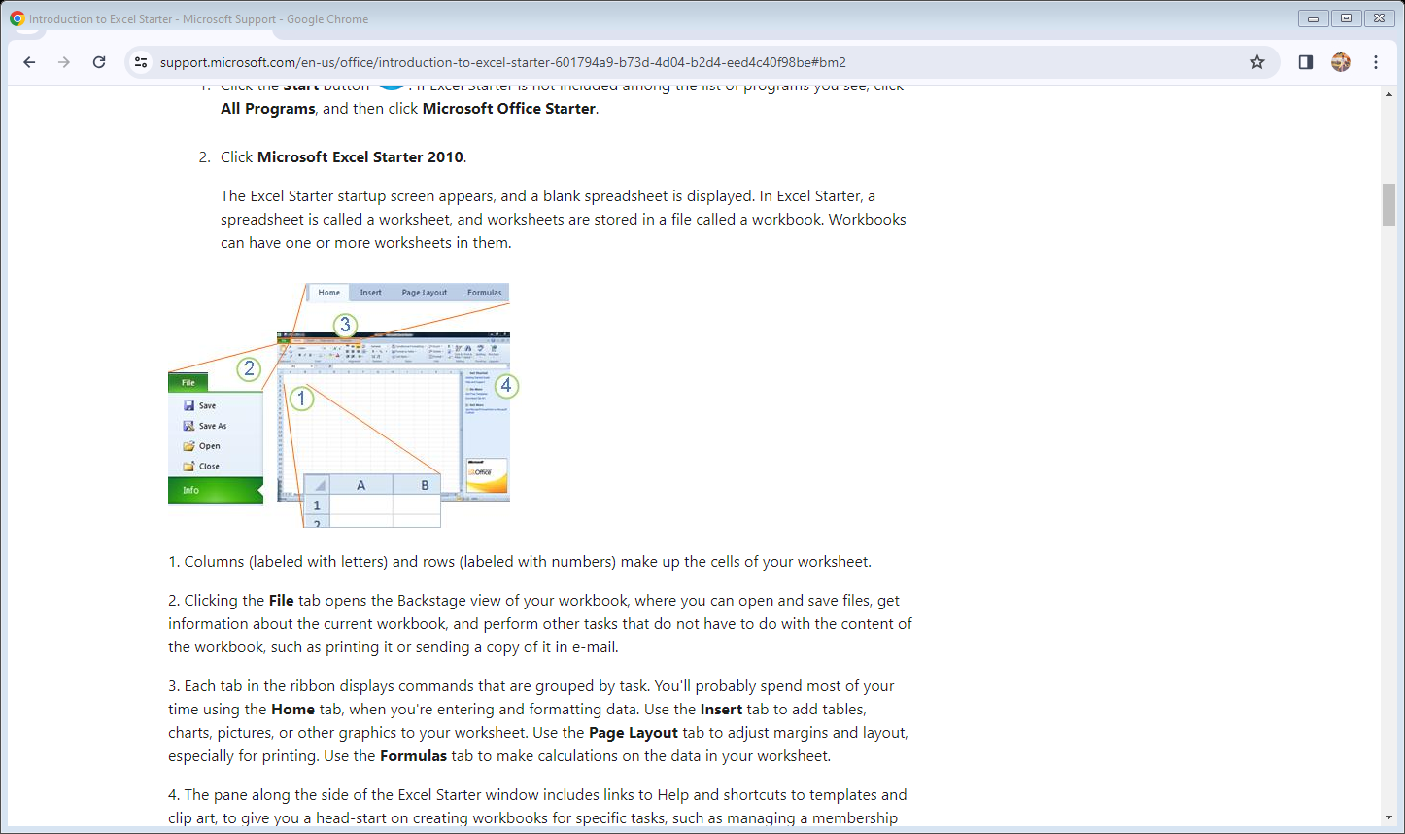
Click the Start button start button. If Excel Starter is not included among the list of programs you see, click All Programs, and then click Microsoft Office Starter. Click Microsoft Excel Starter 2010.

Slide 4
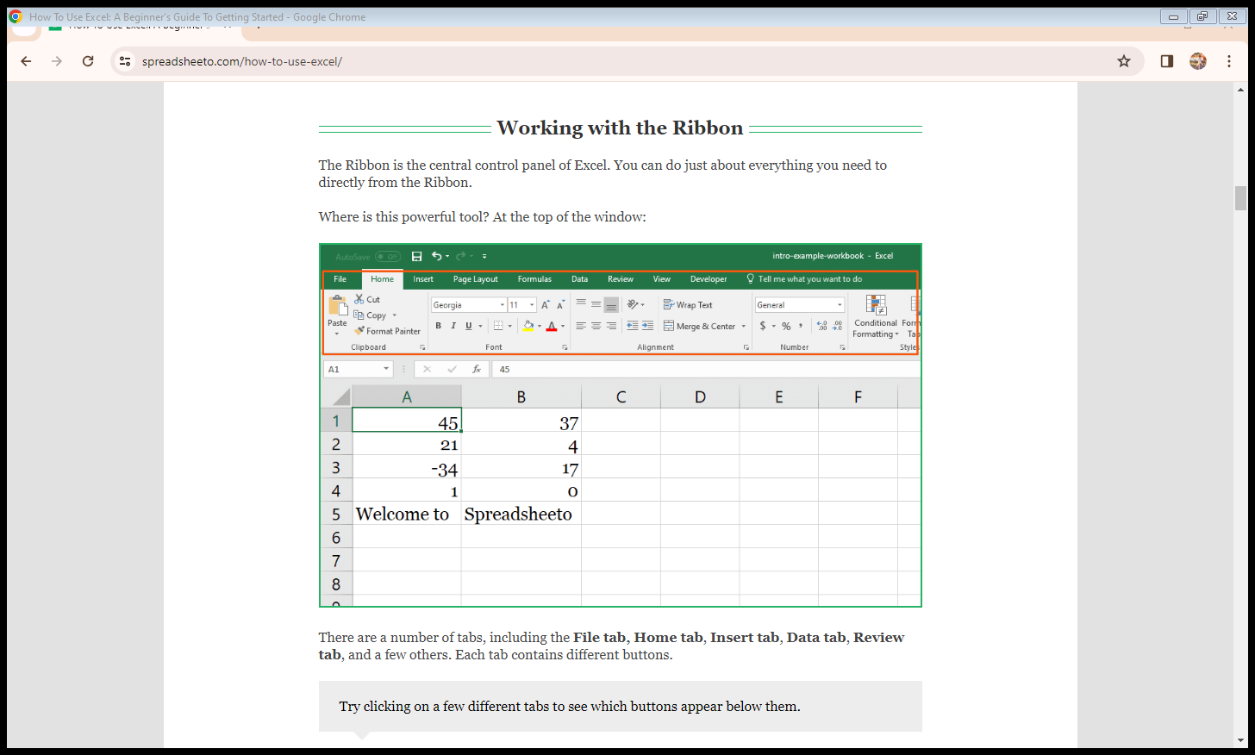
Working with the Ribbon

Slide 5
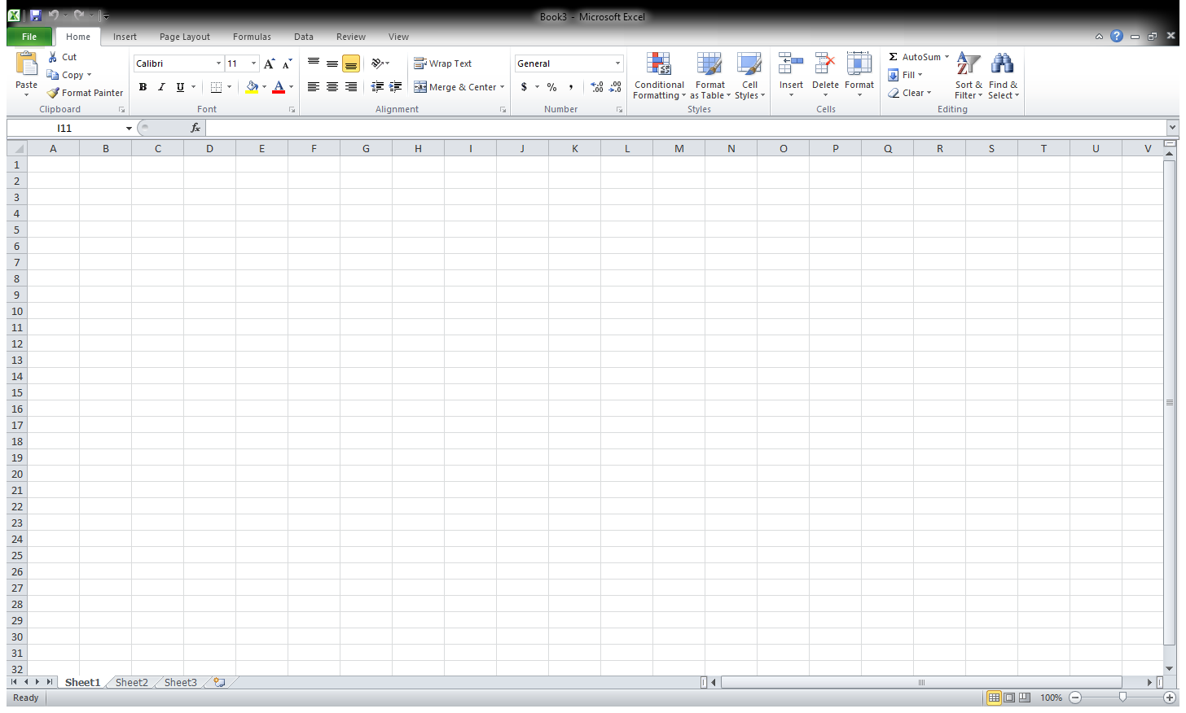
Your worksheet

Slide 6
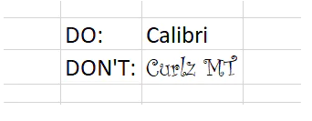
Font type

Slide 7
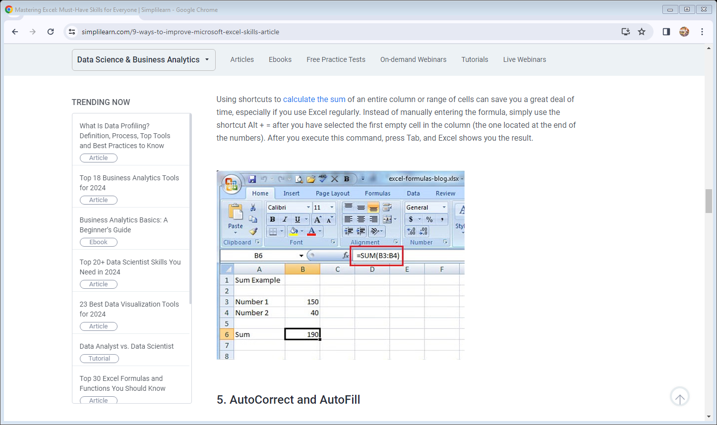
Calculate the Sum

Slide 8
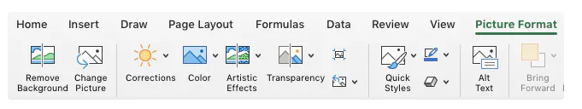
Add an image

Slide 9
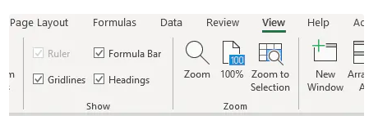
Go off the grid

Slide 10
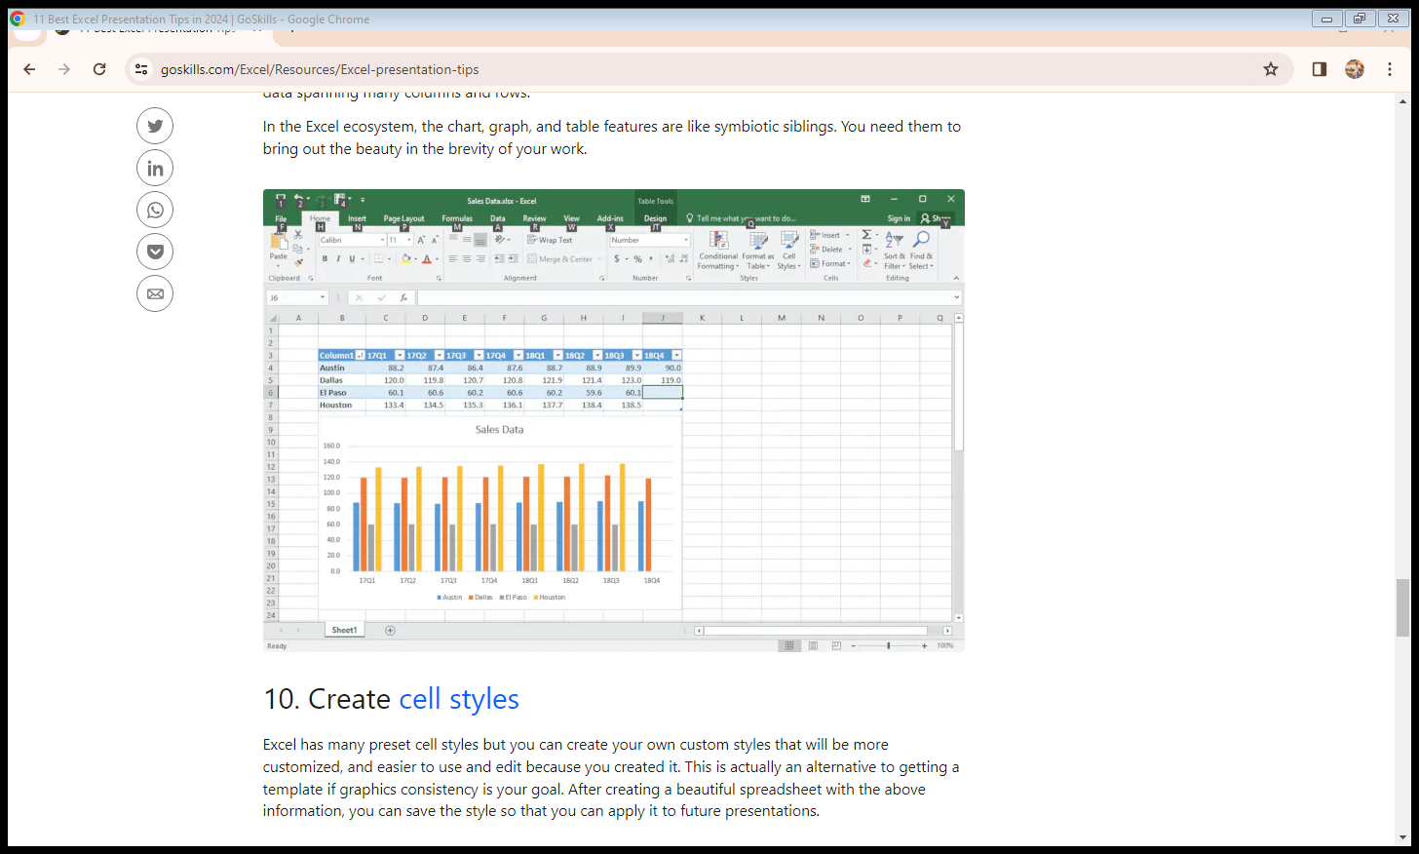
Use charts, tables, and graphs

Slide 11
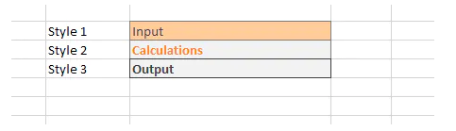
Create cell styles

Slide 12
THANK YOU

